Slide 1


Kepler NextGen
Sales and Service Architecture
Ramata WATH
20/01/2023

Slide 2

1. | Scope
2. | Application Diagram Level 1
3. | Application Diagram Level 2
4. | Components overview
5. | Integration Architecture LV1
6. | Integration Architecture LV2
7. | Development lifecycle
8. | Integration with Heroku
9. | Integration with CustomerTimes/EasyPicky
10. | Access strategy
Contents

Slide 3
1
Kepler Sales and Service Scope

Slide 4




Europe B2B Sales application available online and offline dedicated to field force
CONCRETLY WHAT DOES IT DO ?
Customer Management
Customer, prospect and contact management
Partner function and territories assignation
Visit Execution
Visit planning
In Store activities (Linear survey, Merch, Sellout target & KPI)
Sell in / Order taking
Product, pricing & catalog
Order and promotion

Slide 5


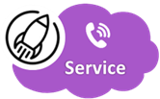

Europe B2B Customer Care application to handle all interactions around customers
CONCRETLY WHAT DOES IT DO ?
Customer Case Management
Case creation, attribution & resolution
Customer Care territory management
Interaction with customer
OmniChannel
CTI
Email-to-Case, Mail bot, Outlook Add on
Live Chat
SAP
Customer care agent collaboration
Chatter
Case transfer
Cross product activities

Slide 6





Europe B2B Customer Care application to handle all interactions around customers
CONCRETLY WHAT DOES IT DO ?
Customer Care Agent (B2B)
2 – Case Creation
manual or automatic
3 – Case Assignation
to 1 CC Agent
4 – Case Resolution
with actions into KEPLER Service or SAP if needed.
Depending of the Type of Requests/Claims.
Reassignement with other agents if needed.
5 – Case Closure
manual or automatic
from 10/2020
1 - Request entry

Slide 7
Kepler Sales and Service : From Current Gen to NextGen
AS-WAS CurrentGen
AS – IS NextGen
TO BE
Kepler Sales
Kepler Sales
Kepler Sales
Backend CT
+
Front End CT
Backend CG Cloud
+
Front End CT
Backend CG Cloud
+
Front End CG
Kepler Service
Kepler Service
Service Cloud
Service Cloud
Kepler Service
Service Cloud

Slide 8
Kepler Sales and Service : Org Strategy and Market segmentation
CONCRETLY WHAT DOES IT DO ?
One shared org between Sales and Service all countries and divisions included
Kepler Service :
Rollout per Country or Hub for all Divisions (multidiv customer care agent)
Currently available for IBERIA, FRANCE, NORDICS, UKI, DEAT, IT
693 active users
Kepler Sales
Rollout per Country and per Division
Currently available for IBERIA (ACD, PPD), WE (ACD), UKI (ACD,CPD,LLD), FR CPD
700 active users
L'Oréal divisions
ACD : Active cosmetics (pharmacies) renamed LDB
CPD : Consumer products (Retail store as Leclerc, Auchan)
PPD : Product professional for Hair stylist (Saloon)
LLD : L'Oréal Luxe as YSL, Lancôme

Slide 9
2
LV1 – Application Diagram

Slide 10
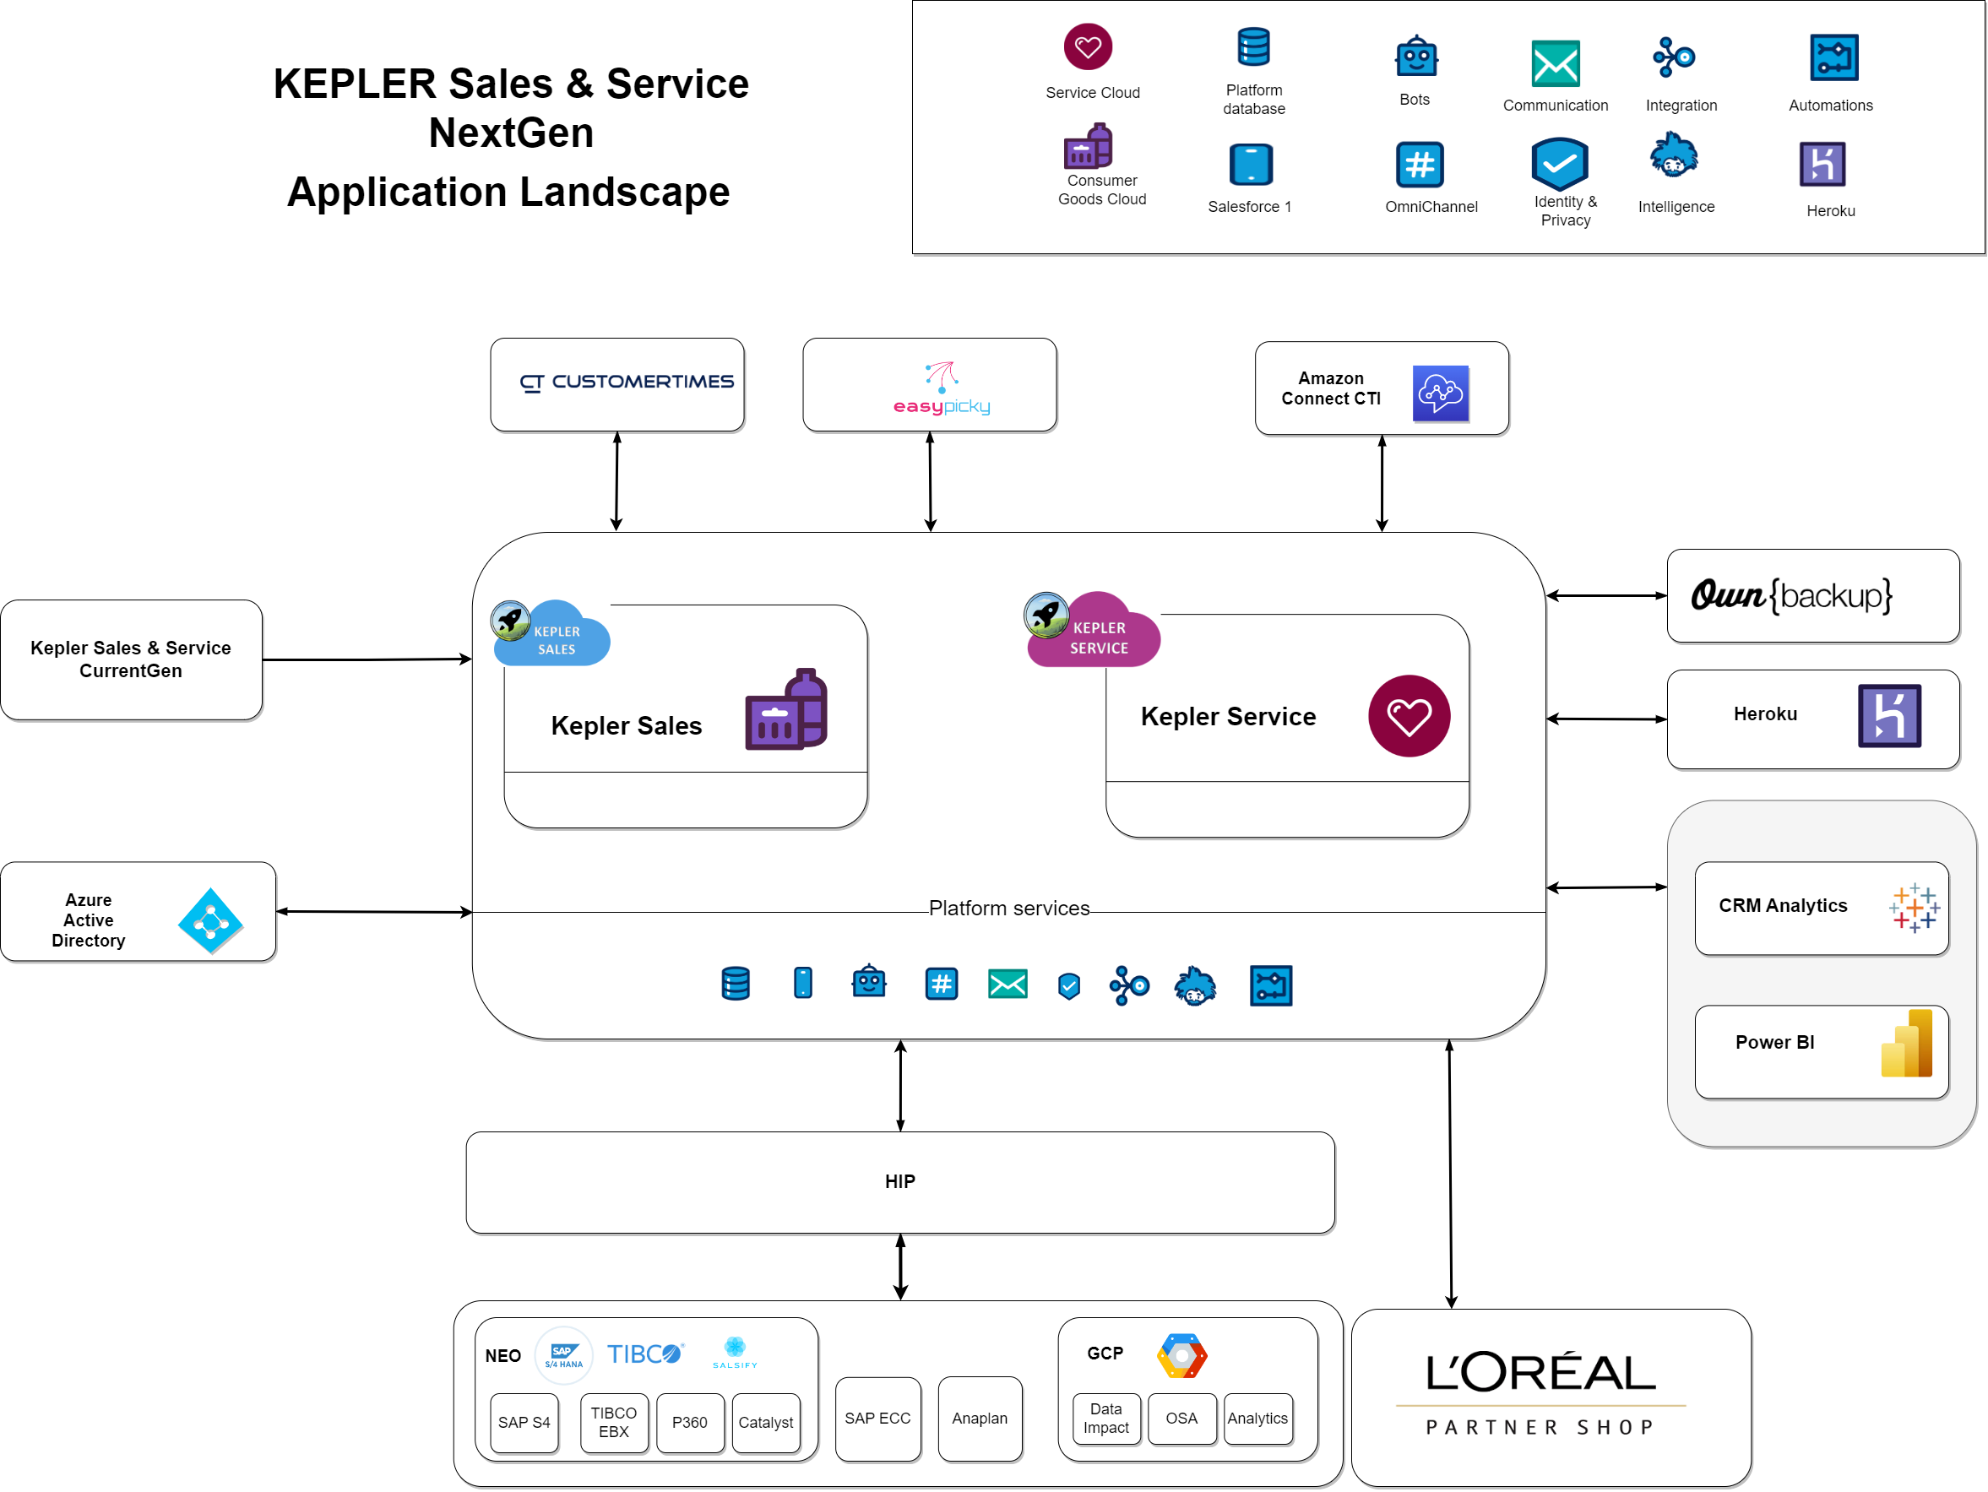
LV1 Application
Diagram

Slide 11

3
LV2 – Application Diagram

Slide 12
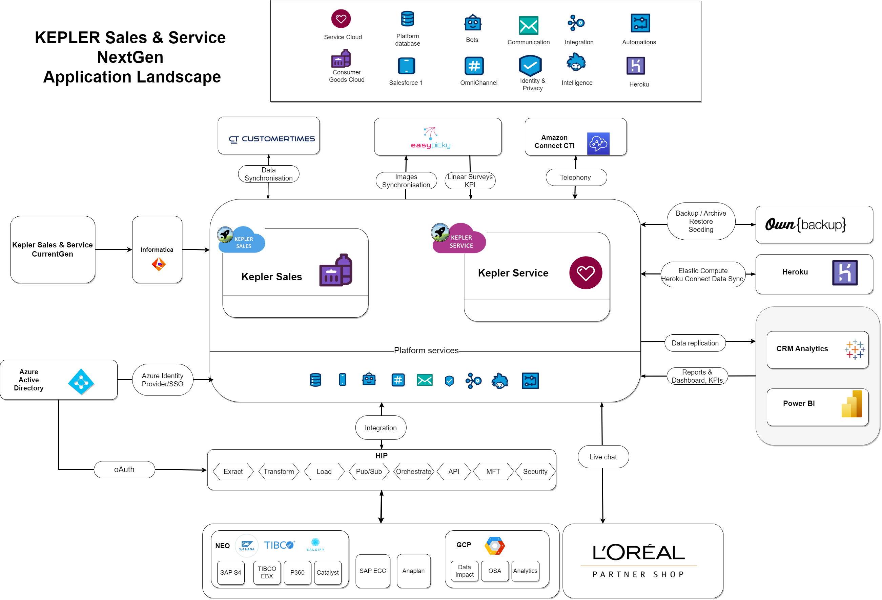
LV2
Application
Diagram

Slide 13
4
Components Overview

Slide 14
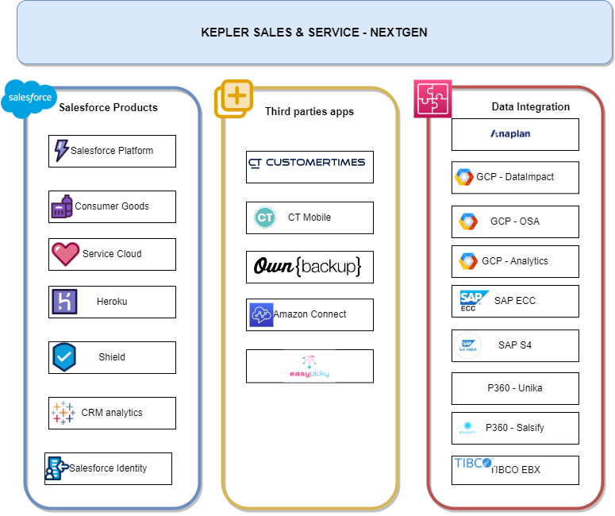
Overview

Slide 15
5
Integration Diagram LV1

Slide 16
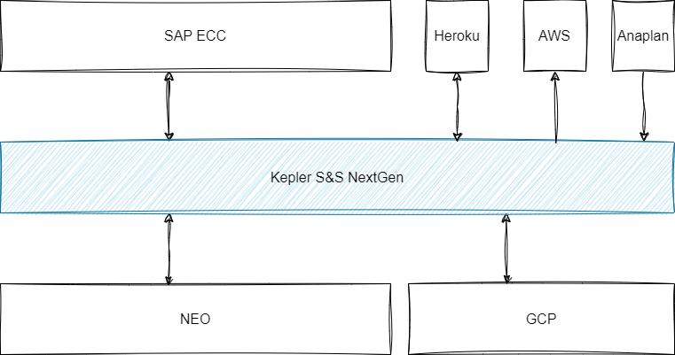
Integration Diagram LV1

Slide 17
6
Integration Diagram LV2

Slide 18
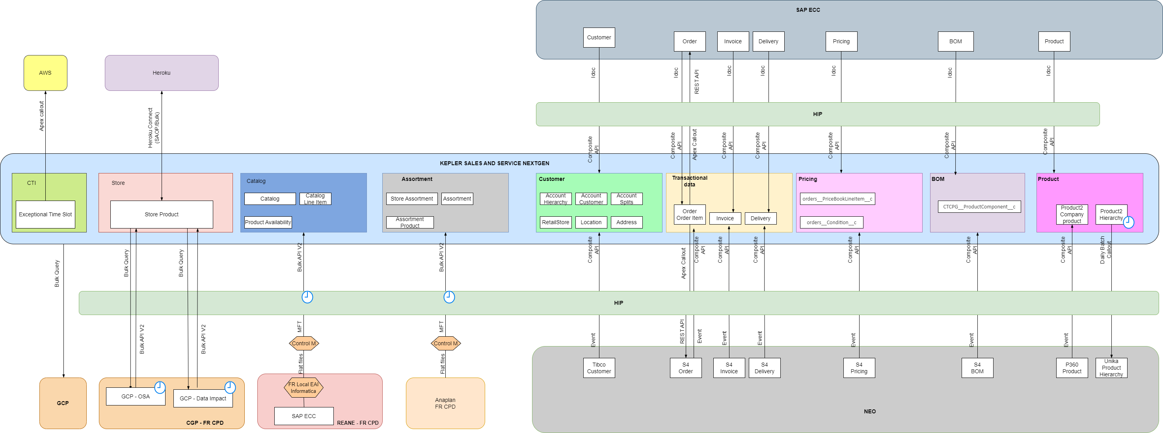
DRAFT - Integration Diagram LV2

Slide 19
7
Development & Deployment

Slide 20













Development & Deployment
PLAN
DESIGN
BUILD
DEPLOY
TEST
RELEASE
OPERATE
DEVELOPMENT
SOURCE CONTROL
CODE REVIEW
CODE QUALITY
CONITINIOUS INTEGRATION
Pipelines to deploy in the different sandboxes and PROD
Pipelines to deploy in the different sandboxes and PROD
Backups
Document management
Code written and committed locally
Pipelines to deploy in the different sandboxes and PROD
Source code management
Nightly analysis on Develop
Analysis on each Pull Request
Automated tests with Tosca
Enhancement
Demand
Story
Incident
Defect
Pull Request by the developer Code review by the Tech Lead
Developers build features using sandboxes
Version Control
Command Line used in the pipelines
Command Line used in the pipelines
Command Line used in the pipelines
Chat
Collaboration
Developers build scripts to calculate

Slide 21
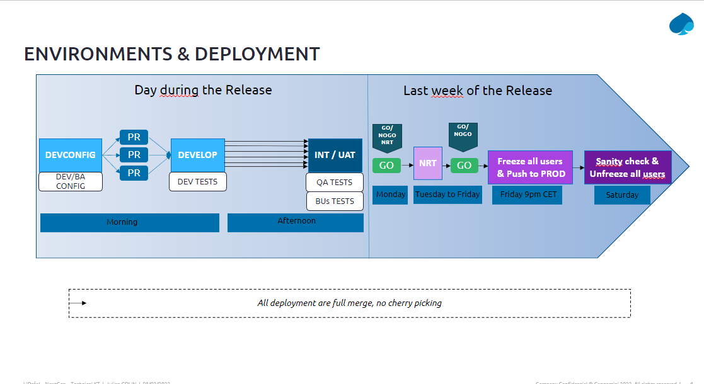
Orgs and Deployment

Slide 22
8
Integration with Heroku

Slide 23
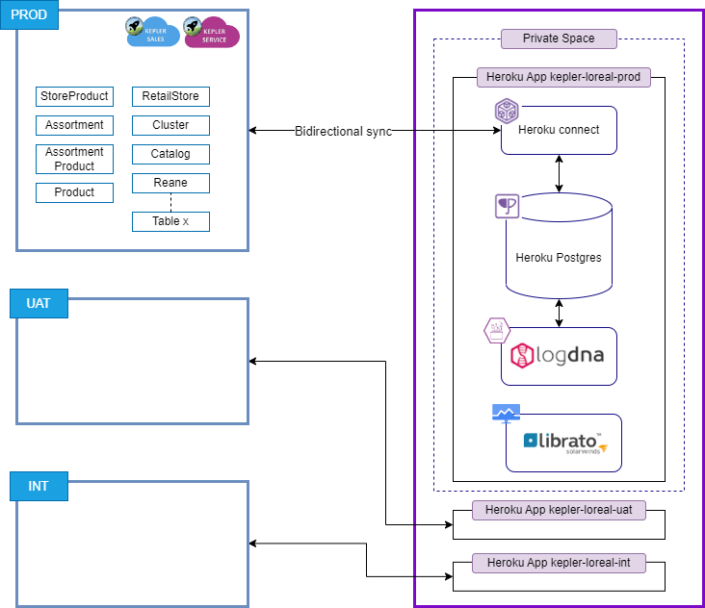
Integration with Heroku

Slide 24
9
Integration with CT(Customer times)

Slide 25
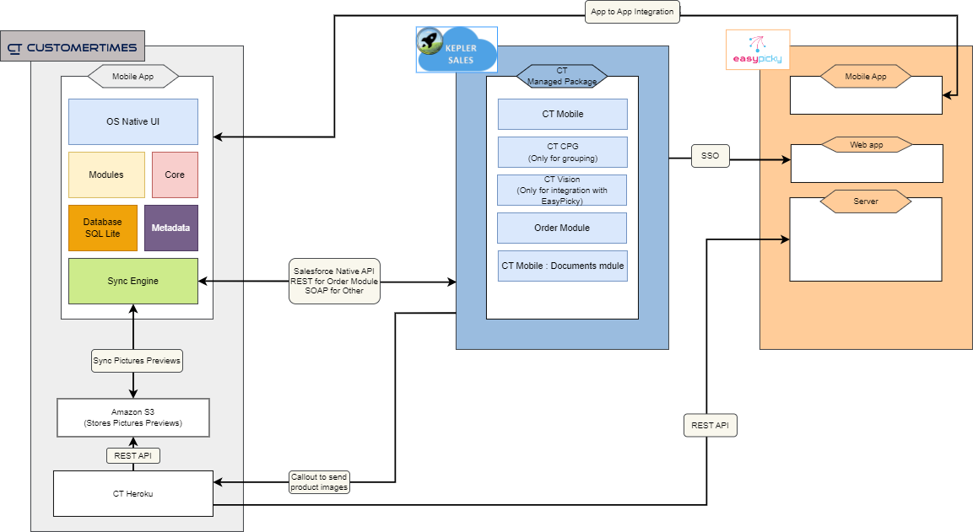
Integration with CT

Slide 26
10
Access Strategy

Slide 27










ACCESS STRATEGY
Current Gen
Salesforce
Authenticator
Trusted Device
in Trusted Network
Front End Users
Back End Users
Trusted Device
in Trusted Network
Trusted Device in
Trusted Network
Internal Users
Authenticator.cc
External Users

Slide 28
ACCESS STRATEGY
Next Gen
Trusted Device
in Trusted Network
Front End Users
Back End Users
Trusted Device
in Trusted Network
Trusted Device in
Trusted Network
Internal Users
Authenticator.cc
External Users

Slide 29
THANK YOU!

